Slide 1

Mother & Baby SmartCare
Presented by Syeda Nawal Naqvi (2022-KS-357) and Sibgha Arfan (2022-KS-354)
Supervisor: Prof. Hasan Raza
BS Information Technology, Session 2022-2026
Govt. Graduate College, Civil Lines, Sheikhupura

Slide 2
Introduction
Mother & Baby SmartCare is an Android app. It keeps mother and baby health records in one place.
Unlike paper files and many small apps, it gives families one safe and simple platform.
At the core, it uses Flutter for the app and Firebase for the data. It shows graphs, makes PDF reports and sends reminders.

Slide 3
Problem Statement and its Solution
Problem: Families track blood pressure, weight, glucose and vaccines. Most use paper files. Some use many apps.
Paper can get lost. Records are hard to find.
Doctors cannot see the full health history.
Solution: One secure app for mother and baby records.
Mother and baby are tracked separately.
Graphs show health trends. PDF reports can be shared on WhatsApp or Gmail.
Reminders help users stay on time.

Slide 4
Objectives of the Proposed System
One secure place for mother and baby records
Roles: mother, father/husband and caretaker
Record blood pressure, glucose and weight
Track baby weight, vaccines and milestones
Show health trends in graphs
Export records as PDF and share them
Send reminders and alerts
Admin panel for users, shop and feedback
Keep health data private and secure
Include a shop for mother and baby products

Slide 5
Scope
Platform: Android only, built with Flutter.
Backend: Firebase (login, data, notifications).
Users: Mother, father/husband, caretaker and admin.
Mother tracker: Blood pressure, glucose, weight, history, allergies.
Baby tracker: Weight, vaccines, milestones. Many baby profiles.
Reports: Graphs and PDF reports. Share through other apps.
Shop: Browse products only. No payments.
Admin: Manages users, shop and feedback. Cannot see health records.

Slide 6
Related System Analysis / Literature Review
App | Weakness | How SmartCare is better
MumWell | No baby tracking, no roles, no PDF | Tracks mother and baby, with roles
What to Expect | No detailed medical data, no roles, no admin | Records medical data. Has roles and admin panel
Baby Connect | No mother tracking, no graphs, no PDF | Tracks both. Has graphs, PDF and admin

Slide 7
Tools and Technologies
Tool | Why we used it
Flutter and Dart | Build the user app and admin panel
Firebase Authentication | Safe login and email verification
Cloud Firestore | Store all data in real time
Google Sign-In | Quick login with Google
Provider | Manage app state
fl_chart | Draw health graphs
pdf and share_plus | Make and share PDF reports
Local notifications | Reminders and alerts
VS Code, Figma, Draw.io | Coding, UI design and diagrams

Slide 8
Functional Requirements
User App
• Sign up, login, Google sign-in
• Email verification, password reset
• Mother health tracker
• Baby health tracker
• Records and graphs
• PDF reports and sharing
• Notifications and login alerts
• Shop, feedback and help
• Profile and settings
Admin Panel
• Admin login and dashboard
• Manage users (block / unblock)
• Manage shop products
• Reply to feedback and help requests
• Send notifications
• Cannot see health records

Slide 9
Non-Functional Requirements
Reliability
• At least 99% uptime
• Shows "No Internet" message, no crash
• No saved record is lost
Usability
• Sign up in under 2 minutes
• Main features within 2 taps
• Light and dark themes
Performance
• Home screen loads in 3 seconds
• Data saves in 2 seconds
• PDF ready in 5 seconds
Security
• Passwords stored safely
• Each user sees only own data
• HTTPS and email verification

Slide 10
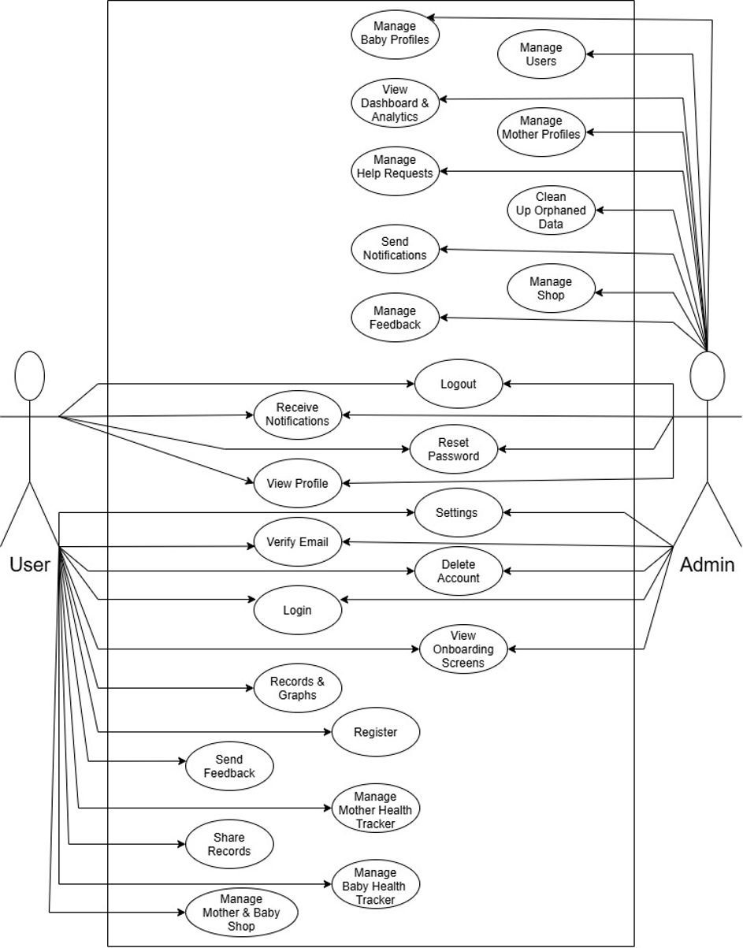
Use Case Diagrams
Two actors: User and Admin.
User can: sign up, log in, track mother and baby health, view graphs, share PDF, shop, send feedback, manage profile.
Admin can: manage users, shop, feedback and help requests, and send notifications.
Privacy: Admin cannot see private health records.

Slide 11
User Scenarios
New mother: Signs up, picks a role and verifies her email. Then she sees the home screen.
Daily tracking: She adds blood pressure and weight. She adds her baby's vaccine.
Check progress: She opens Records & Graphs and sees the trend.
Visit the doctor: She makes a PDF report and shares it on WhatsApp or Gmail.
Need help: She sends feedback. Admin replies and she gets a notification.

Slide 12
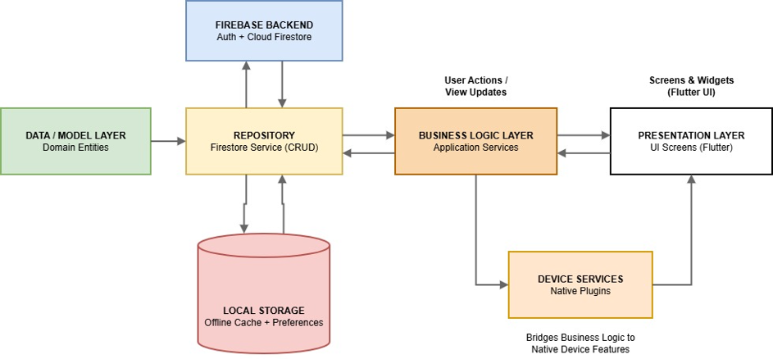
System Design
Layered architecture in a client-server setup.
Layers: Presentation, Business Logic, Repository and Data Model.
Firebase handles login and data. Local storage keeps cached data.

Slide 13
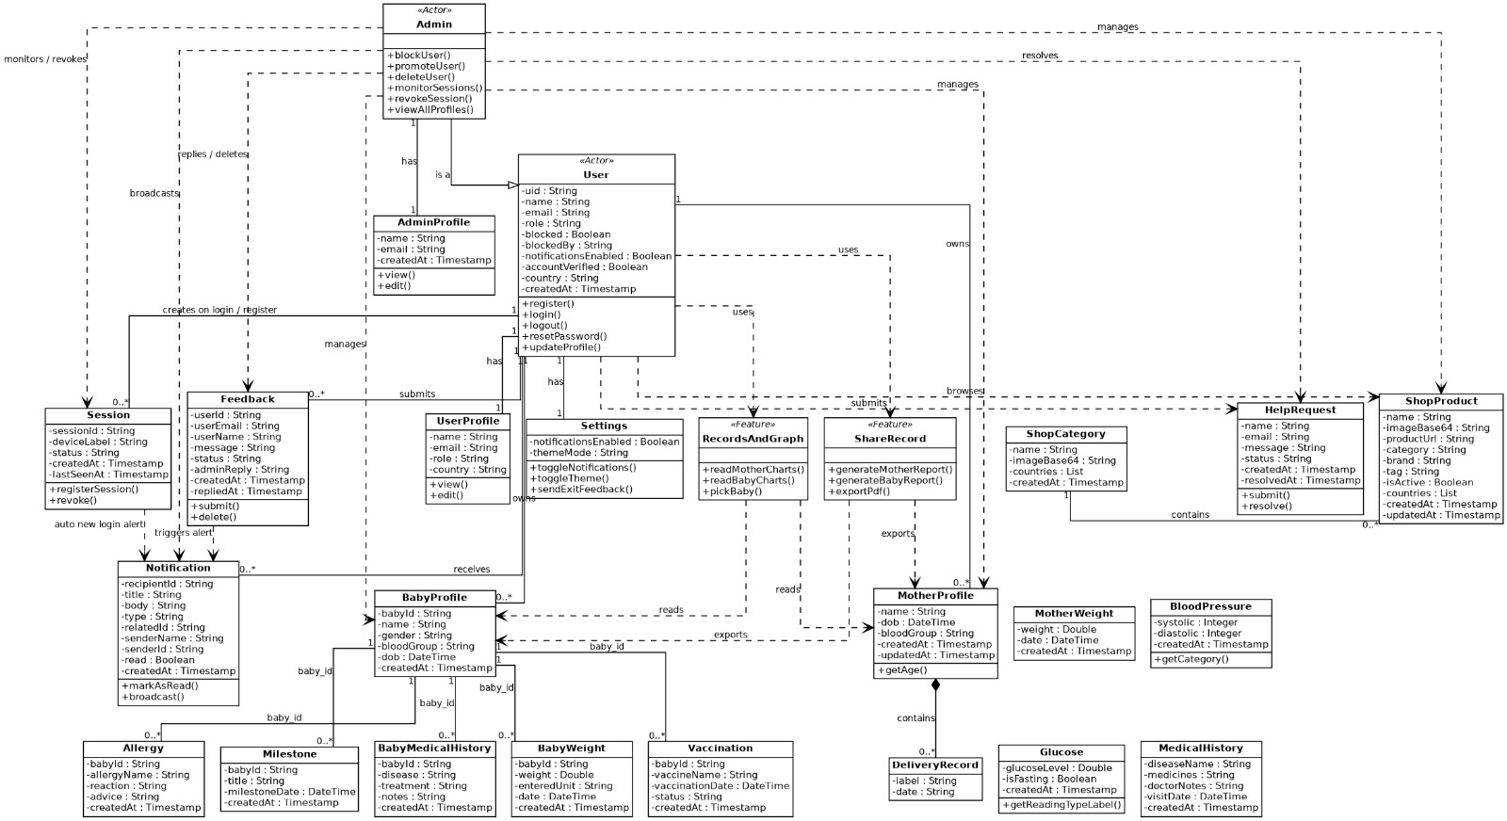
Class Diagram
Main classes: User, MotherProfile, BabyProfile, BloodPressure, Glucose, Weight, Vaccination, Milestone, Notification, Feedback, ShopProduct

Slide 14
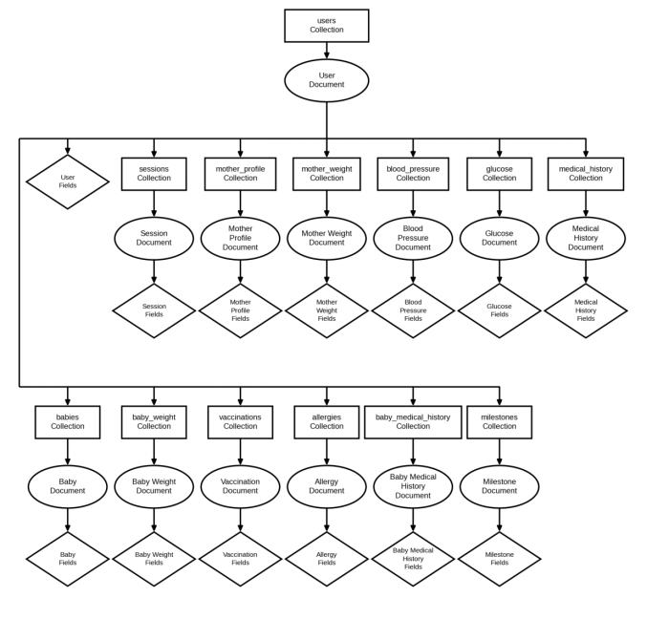
Hierarchy of Firestore Collections
• Firestore is NoSQL, so data is kept as collections and documents.
• Each user is one document.
• Mother and baby records are sub-collections under that user.
• Mother: blood pressure, glucose, weight, history, allergies.
• Baby: weight, vaccines, allergies, milestones.

Slide 15
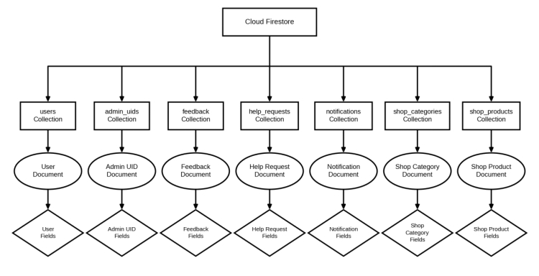
Database Model
Database: Cloud Firestore (collections and documents).
Main collections: users, admin_info, feedback, help_requests, notifications, shop_categories, shop_products.

Slide 16
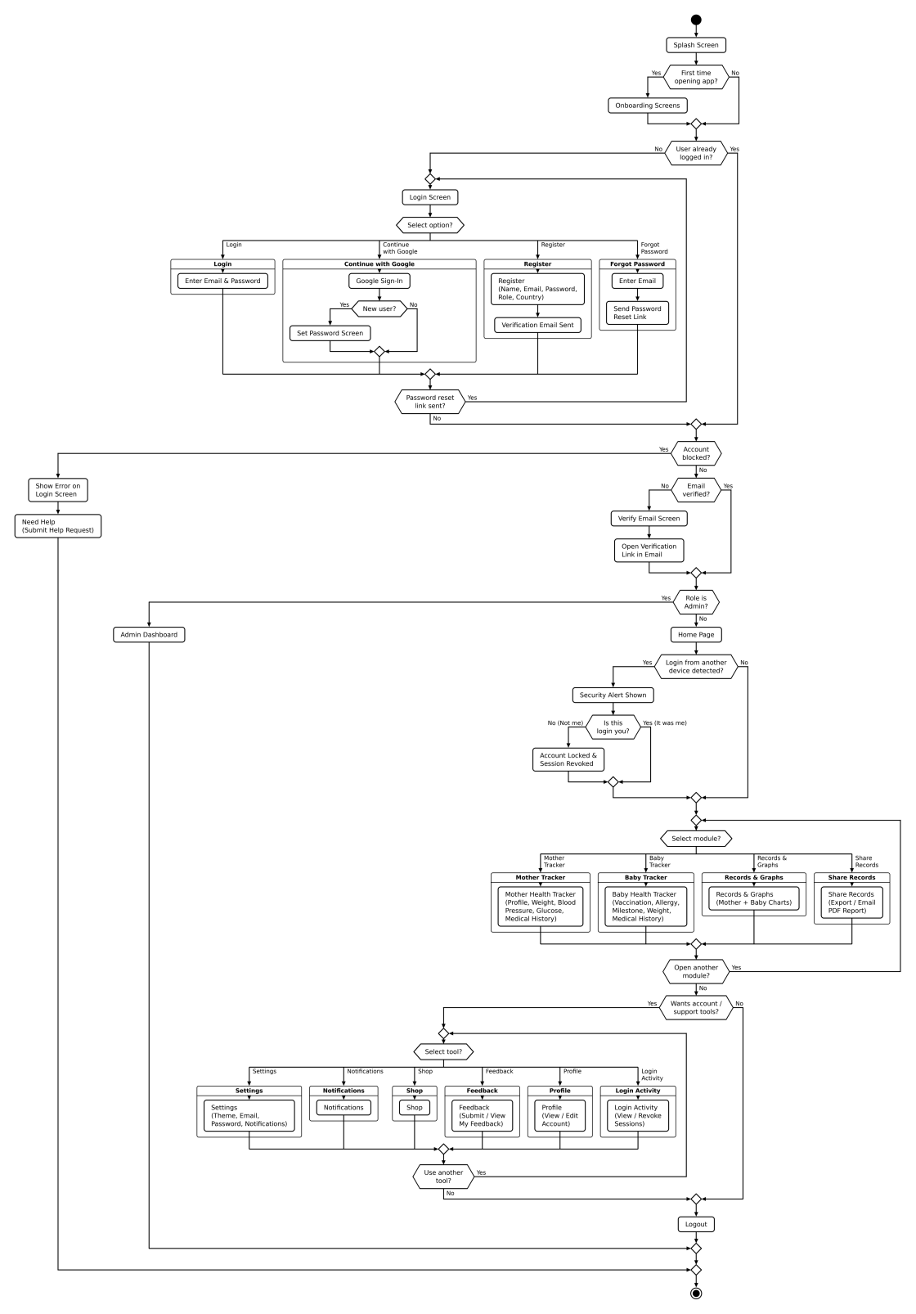
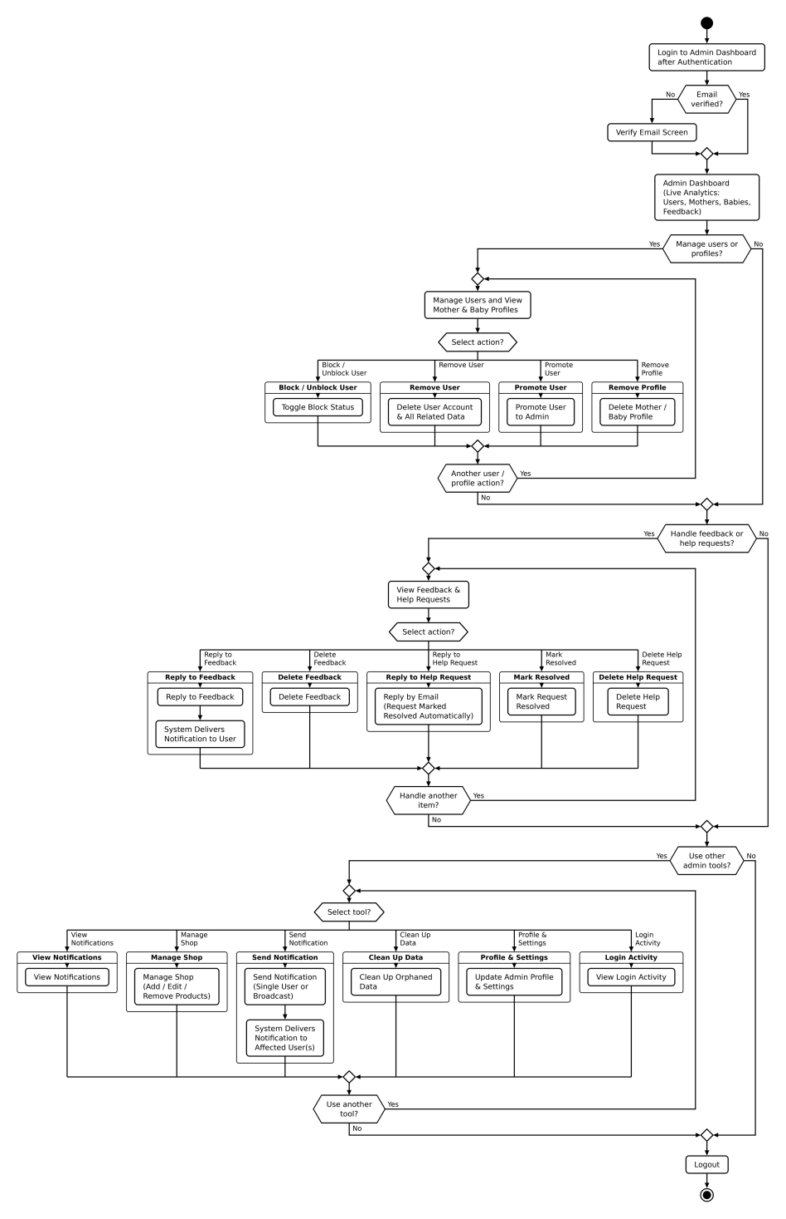
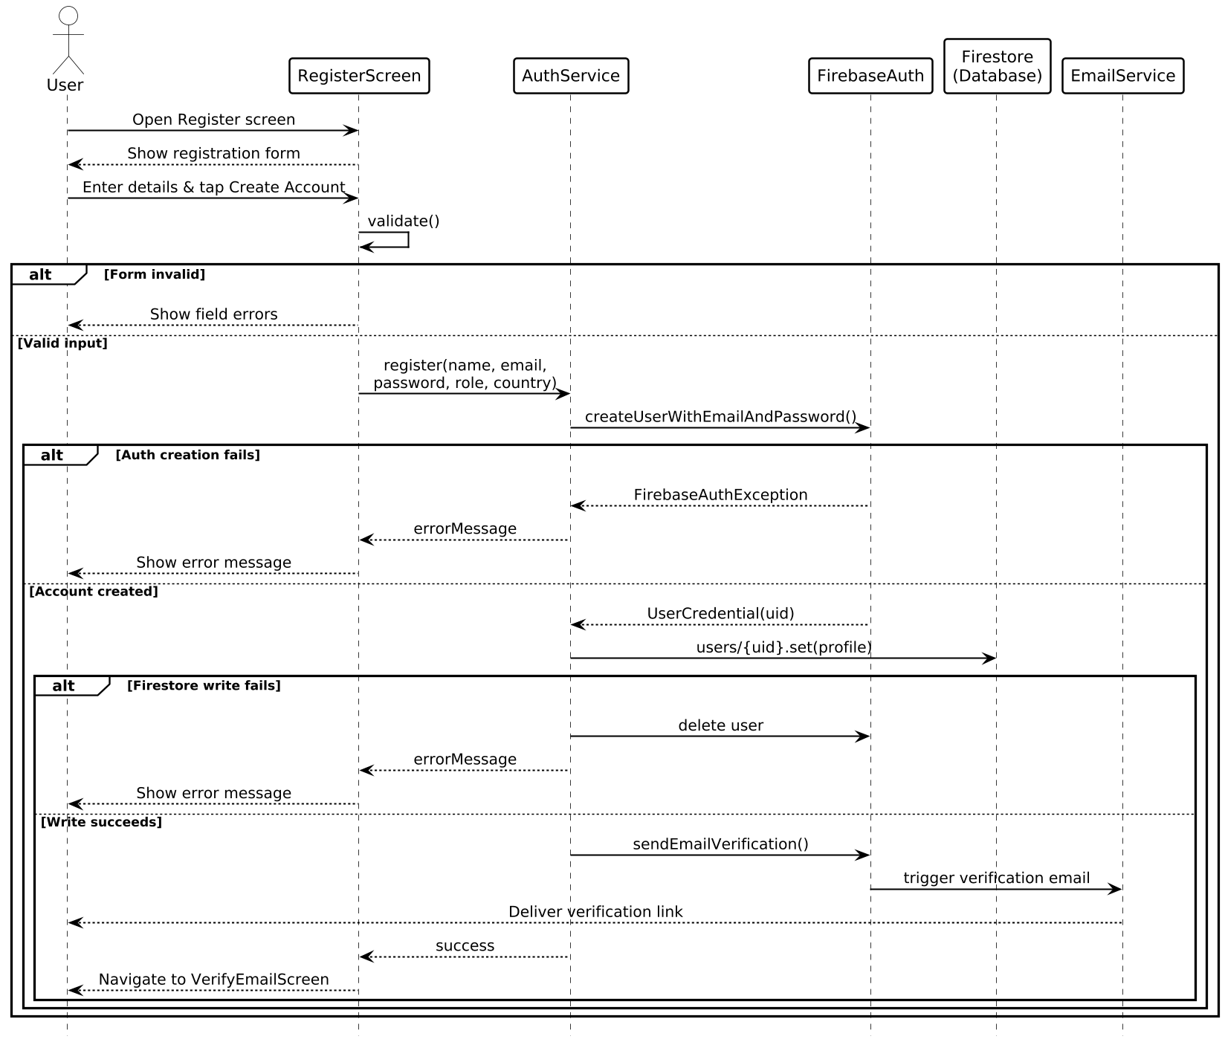
Activity Sequence Diagram
User activity flow
Admin activity flow
Sequence: user registration

Slide 17

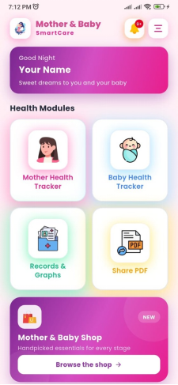
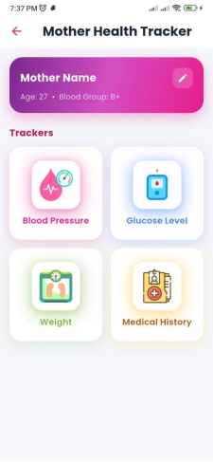
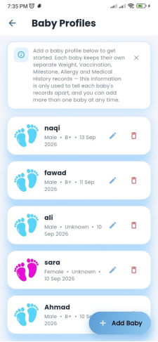
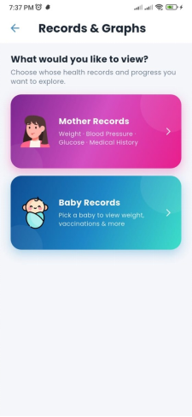
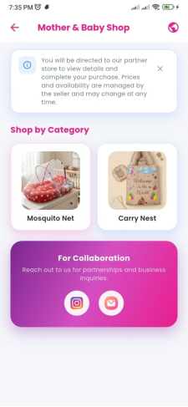
User Interfaces
Splash
Home
Mother Tracker
Baby Profiles
Records & Graphs
Shop

Slide 18
Thank You

